Slide 1
Getting to know the Hardware: The MSP430F5529 Architecture & Memory Map
Lecture #4-5

Slide 2
Getting to know the MSP430 Hardware
In a Programming course – Typically its all about the code
Read in data
Manipulate data
Output/Store data
>> Learn syntax of a high-level language & logical and algorithmic approaches to solving some (common) problems
>> Use a very high-level view of a computer

Slide 3
Getting to know the MSP430 Hardware
Use constructs
loops, arithmetic operations, searches, if-then-else, sorts, calculate
Software: Write function & syntax correctly and it will run
Use library functions for I/O read(), getchar(), send(), printf(), putchar() …
Monitor
Computer
Disc, I/O
Keyboard

Slide 4
Getting to know the MSP430 Hardware
>> Developing SW for embedded systems requires much more in-depth knowledge of target microprocessor
Need to understand architecture of the processor
How & Where code and data are stored
How much memory & what resources are available

Slide 5
General Microprocessor System HW Architecture
CPU = Central Processing Unit = Core or brains of computer
Executes program instructions
Provides timing
Controls/Directs operation of memory and peripherals
Memory = Stores binary information
Under control of CPU (memory is DUMB!)
2 main types
Non-volatile -> ROM/FLASH = code Memory
Volatile -> RAM = Data Memory
Peripherals = Everything that’s not memory
Provide means of exchanging data with the I/O devices
I/O Access is similar to Memory Access in Embedded Systems
Memory Mapped Peripherals
CPU, Memory, Peripherals connected through
data lines, address lines & control lines
Bus
Multiple connections in parallel
CPU
Control lines
Memory
Address Bus
Data Bus
Peripherals
(I/O devices, etc.)

Slide 6
General Purpose (PC-style) Computing Hardware/Software Hierarchy
Applications Office, Matlab
Operating System = User Interface Win 10, Linux, MacOS
System SW = Interface to HW (Hardware Abstraction Layer) Device Drivers, BIOS
HW Layer = CPU, MEM., Peripherals

Slide 7
Embedded System Computing Hardware/Software Hierarchy
Everything gets “squashed” in an embedded system…
Application (singular!)
Closely integrated with Hardware Layer
I/O is Low Level
Reads/Writes to pins of Microprocess
Little or no wrapping of I/O functions (no printf(), etc.)
Applications
Operating System/OS
HW Layer = CPU, MEM., Peripherals

Slide 8
Architectures
>> Most microprocessor/microcontrollers are use one of the following architectures
Von Nuemann (or IAS or Princeton) Architecture
-- first used for IAS Computer (~1952)
Harvard Architecture
-- first used by Harvard Mark I (~1944)

Slide 9
Harvard Architecture
Separate Memory for Data and Instruction
Data and Instruction Fetch happens at the same time
Single instruction cycle
More complicated and costlier development
Code Mem
Instr Addr
CPU
Data Addr
Data Mem
Code
Data Bus
Control
Control
Peripherals

Slide 10
Von Neumann Architecture
Same Memory for Data and Instruction
Data and Instruction Fetch happens on different times
2 instruction cycles
Easier and cheaper development
Used by most “general purpose” processors
MSP430 also uses this
CPU
Data Addr
Memory
(Code)
(Data)
Data Bus
Control
Peripherals

Slide 11
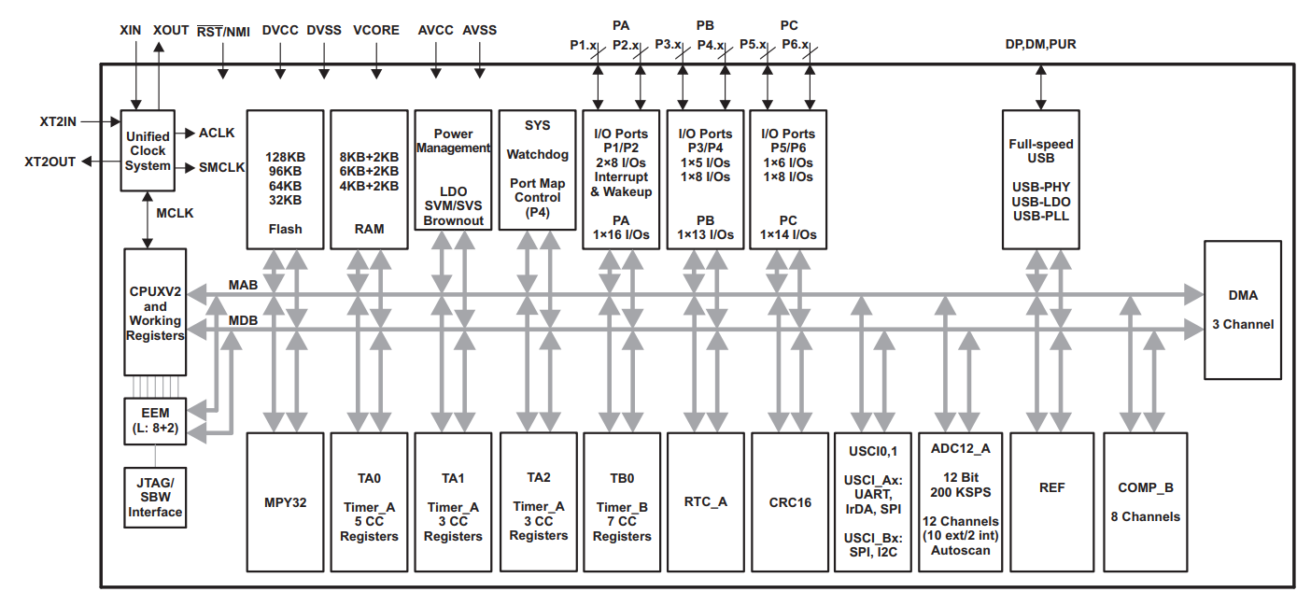
MSP430F5529 – Functional Block Diagram
>> MSP 430 family contains over 100 versions of this CPU with various memory/ peripheral configurations
--Really a “System on a Chip”
MAB -> Memory Address Bus
MDB -> Memory Data Bus
>> We'll be using MSP430F5529
128 KB Flash memory > Code storage
8 KB RAM (+2 KB RAM associated with USB) > Data storage
LCD controller
32-bit Hardware multiplier, Serial interfaces (UART), analog to-digital converter (ADC) and a slew of other peripherals
Multiple timers, comparator, USB controller, DMA, general IO ports...

Slide 13
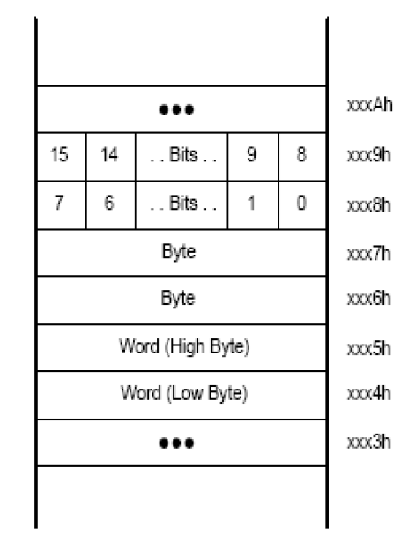
Memory Organization
>> Memory = group of sequential locations where binary data is stored
In MSP430, each memory location holds 1 byte
Each byte has unique address which CPU uses to read to and write from that location (think “mailbox”)
Multibyte data is stored Little Endian! (low byte, high byte)

Slide 14
Memory Organization
Words are aligned with even addresses
Low byte always stored at even address
Byte F3h is at address 02401h
Word F307h is at address 02400h
Address | Byte Value
… | …
02403h | 02h
02402h | 02h
02401h | F3h
02400h | 07h
… | …
Word = F307h
Addr = 02400h

Slide 15
Volatile vs Non-volatile Memory
Volatile
Loses contents when power removed or interrupted
RAM
8 KB (+2 KB) = DATA memory = Volatile
Read and Write = retrieving or writing DATA to/from RAM (under programmer control)
(MSP430F5529 –has a RAM retention low power mode)
Non-Volatile
Keeps contents when power removed or interrupted
FLASH
128 KB = CODE memory (primarily!) = Non-volatile
Fetch = retrieving of instruction from CODE (Flash) memory (automatic CPU function)
Flash is writable under program control
time required to write >> time required to read
Must be erased in multi-byte segments (e.g 512 bytes)

Slide 16
MSP430 is 16-bit microcontroller
>> 16-bit word size => 16-bit internal registers
>> 16-bit data bus
>> BUT MSP430x5xxx and '6xxx families have and extended 20-bit memory address bus to allow access to up to “1MB” of memory
>> Each bit in bus has its own electrical connection!
Parallel bus
CPU
A₁₉
Address
Memory
A₁₈
Register 0
A₀
D₁₅
Register 15
D₁₄
D₀
Data

Slide 17
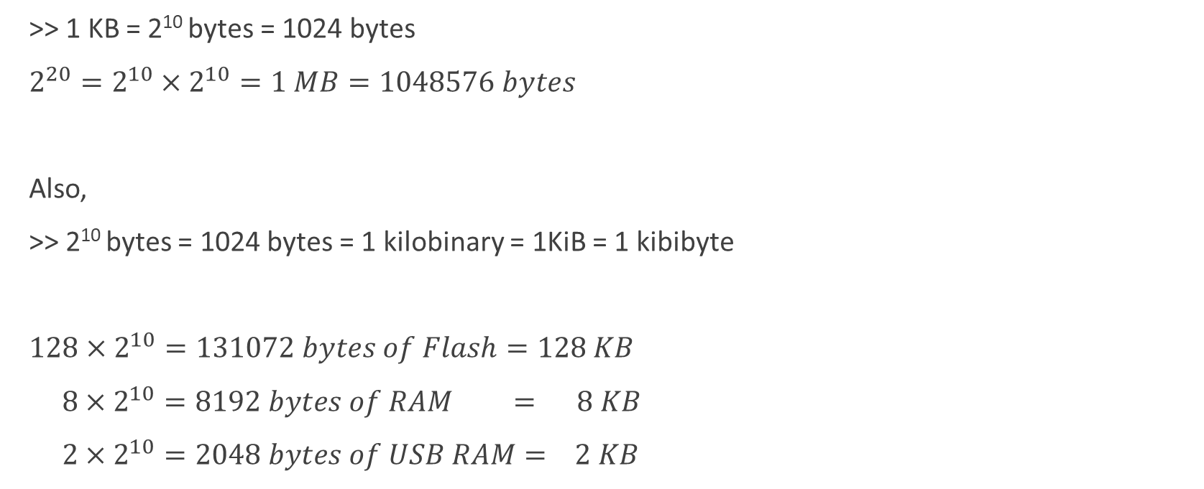
Memory Size Conversion
>> 1 KB = 2¹⁰ bytes = 1024 bytes
$2^{20}=2^{10}×2^{10}=1 MB=1048576 bytes$
Also,
>> 2¹⁰ bytes = 1024 bytes = 1 kilobinary = 1KiB = 1 kibibyte
$128×2^{10}=131072 bytes of Flash=128 KB$
$8×2^{10}=8192 bytes of RAM = 8 KB$
$2×2^{10}=2048 bytes of USB RAM= 2 KB$

Slide 18
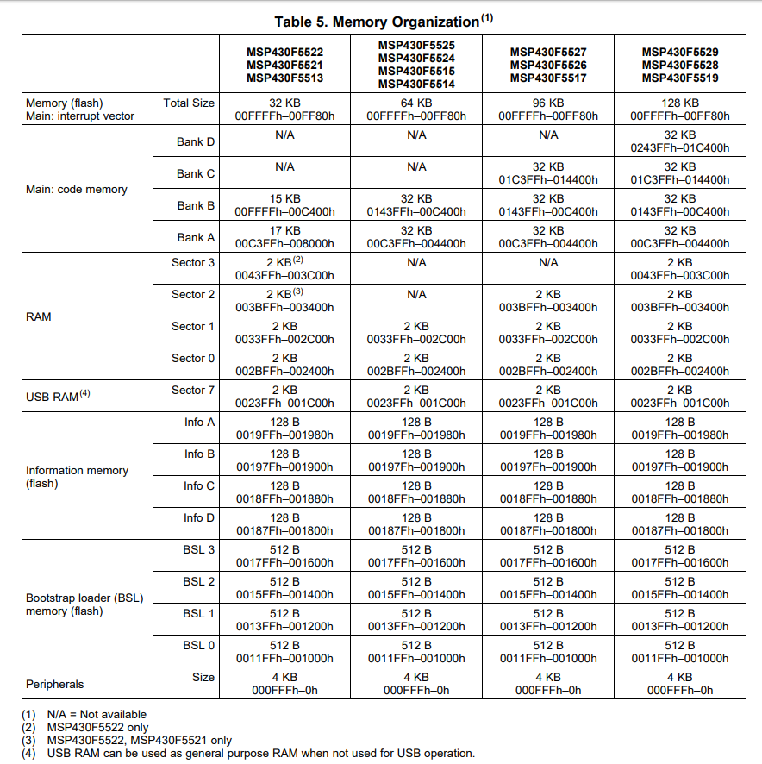
Memory Organization
>> RAM starts at 02400h, implemented in 2KB banks (sectors)
Variables used during program execution are stored in RAM
>> Our 128 KB of Flash starts at 04400h and ends at 0243FFh.
(Interrupt Vector Table is written within Flash)
>> Code is written to Flash when you program the chip from CCS starting at address
04400h (by default, can give compiler directives specify other location)

Slide 19
Internal Registers
>> There are sixteen 16-bit register inside CPU
Registers R0 –R3 have dedicated functions
>> Registers R4 –R15 are user registers
Like scratch pad for data values being used by current or recent instructions
Retrieving an operand from a CPU register is much more efficient than reading it in from memory
CCS compiler tries to maximize register use
R0 = Program Counter
R1 = Stack Pointer
R2 = Status Register
R3 = Constant Generator
(20-bits)
Hold addresses -> 20-bits
Used by CPU to control program execution
(20-bits)
(16-bits)
(16-bits)

Slide 20
Peripherals
>>What's the deal with the addresses below 00FFFh assigned to peripherals?
These addresses are associated with the Control and Data registers of the peripherals
Allows for data to be read or written to I/O peripherals as if being read or written to memory
–They are what you use to do IO!!
>> Almost all computer programs require Input and produce Output...

Slide 21
Consider this C code for a General-Purpose computer
#include <stdio.h>
void main(){
charinKey = '-’; // declare variable named inKey
// and initialize to ASCII '-'
while (inKey != 'X'){
/* get character from keyboard */
inKey = getchar();
/* display character entered on screen */
putchar(inKey);
}
}

Slide 22
C code for a General-Purpose computer
How is the Input and Output handled? Is it just a simple bit of software?
>> getchar( )and putchar( ) are C functions and part of the stdio library
➔ Their function prototypes can be found in stdio.h
➔ Also their implementations are part of stdio library which is “included” during the build process (compilation and linking)
>> These “canned” software routines have Why embedded stuff is cool! Always been part of standard C because everybody using general purpose computers has needed to read characters from a keyboard and write to a monitor!
➔ Several computing “layers” below our simple little application a byte has been placed on the microprocessor’s data bus from the PORT attached to the keyboard…

Slide 23
C code for a General-Purpose computer
Byte must be “written” or “read” from voltages applied to or on the package pins of the CPU
Voltages -> Logic Levels 0 or 1
Applications
Operating System = User Interface
System SW = Interface to HW (Hardware Abstraction Layer)
HW Layer = CPU, MEM., Peripherals
getchar( ) and putchar( ) = C Library functions
Monitor
Port B
CPU
Addr Bus
Keyboard
Port A
Data Bus

